Slide 1
Testing introduction
Course “JUnit magic”
Section 1

Slide 2
Agenda
Software Bug
Consequence of Bugs
Bug sources
Who can fix a Bugs?

Slide 3

Software bug

Slide 4
Software bug definition
A software bug is the common term used to describe an error, flaw, mistake, failure, or fault in a computer program or system that produces an incorrect or unexpected result, or causes it to behave in unintended ways.

Slide 5
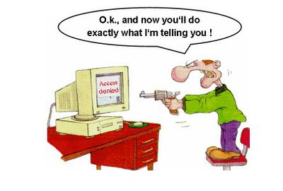
Users don’t like bugs

Slide 6
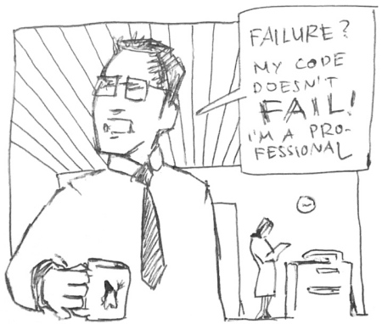
Really?

Slide 7
Consequence of bugs
The results of bugs may be extremely serious:
  In 1996, the European Space Agency's US$1 billion prototype Ariane 5 rocket was destroyed less than a minute after launch, due to a bug in the on-board guidance computer program.

Slide 8
Bug sources
Most bugs arise from mistakes and errors made by people in either a program's source code or its design.

Slide 9
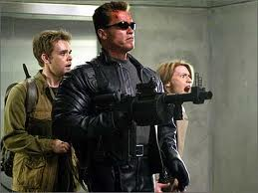
Who can fix a Bug?

Slide 10

Programmers can fix the bugs

Slide 11
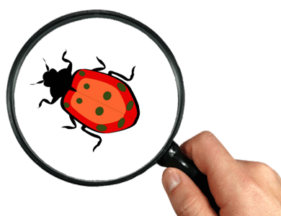
Bug free software?
It is possible to build bug free software?

Slide 12
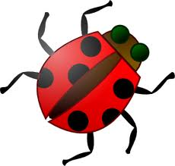
How to reduce the number of bugs?

Slide 13
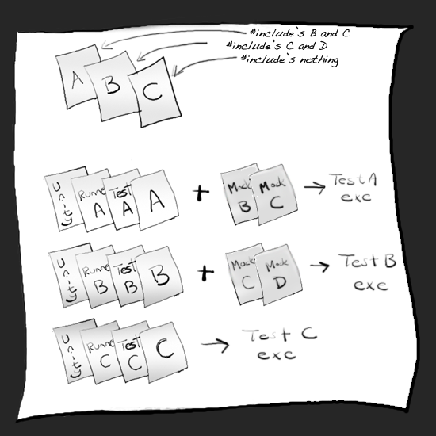
Create tests for your code

Slide 14
Test creation steps
Prepare test data
Invoke production code
Assert output

Slide 15
Test data
Input data for production code
The correct result

Slide 16
Array Sorting test scenarios
We want to write Array Sorting algorithm in Java.
Prepare test scenarios for this algorithm (write it on blackboard)

Slide 17
Test Scenario 1
When: we pass empty array to sort algorithm
Then: we receive empty array

Slide 18
Test Scenario 2
When: we pass array with one element {1} to sort algorithm
Then: we receive array with one element {1}

Slide 19
Test Scenario 3
When: we pass array with two elements {2, 1} to sort algorithm
Then: we receive array with two element {1, 2}

Slide 20

Any Questions?

Slide 21
References
xUnit Test Patterns: Refactoring Test Code: http://martinfowler.com/books.html
Wikipegia: http://en.wikipedia.org/wiki/Software_testing
http://www.softwareqatest.com
http://vyaskn.tripod.com/software_testing_qa_books.htm

